Slide 1

Application Delivery Fundamentals :
Grafana

Slide 2
Goals
Introduction and Overview
Installation
Getting Started with Grafana
Data sources in Grafana
Dashboards & Explore in Grafana
Panels in Grafana
Authentication in Grafana
Administration in Grafana

Slide 3
Goals
Templates and variables
Grafana Enterprise
Plugins

Slide 4
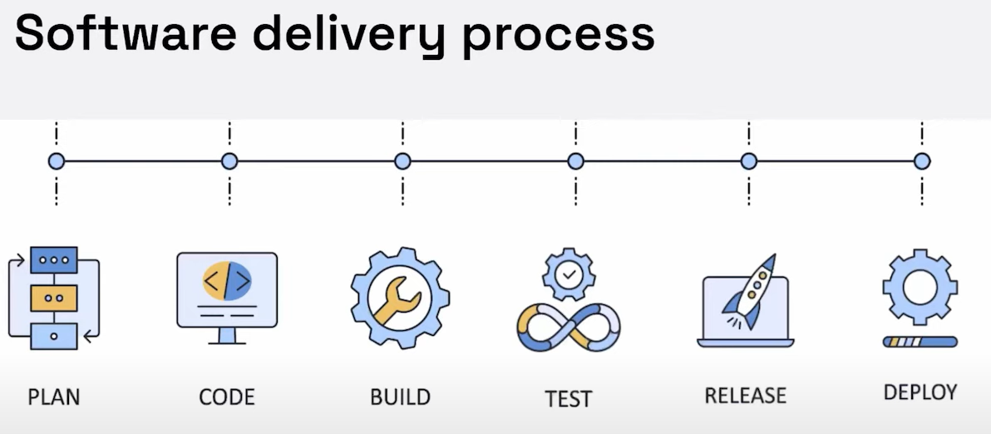
Delivery Process

Slide 5
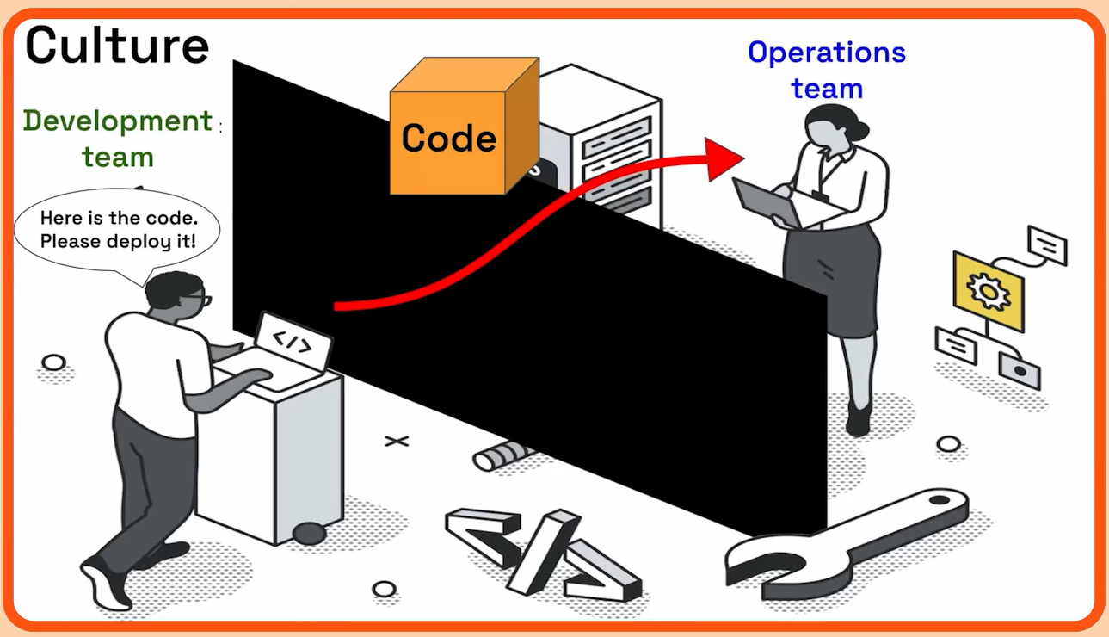
Devops

Slide 6
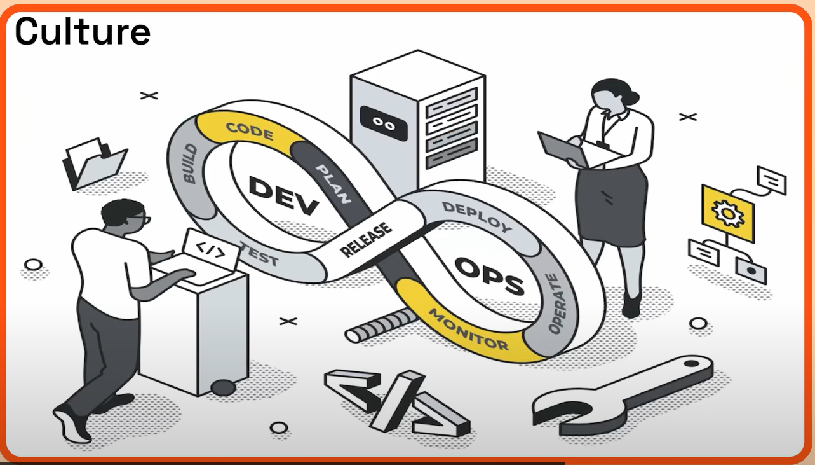
Devops

Slide 7
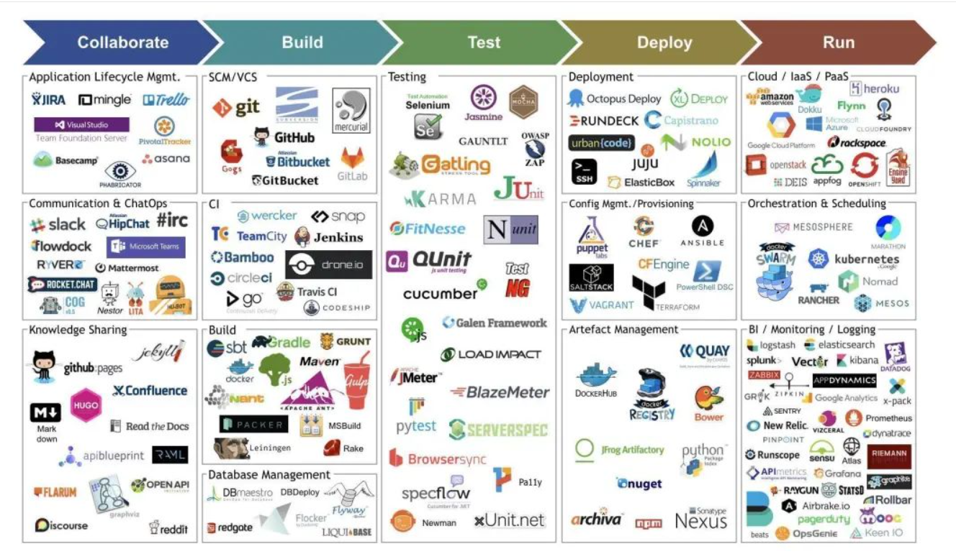
Devops Tools

Slide 8
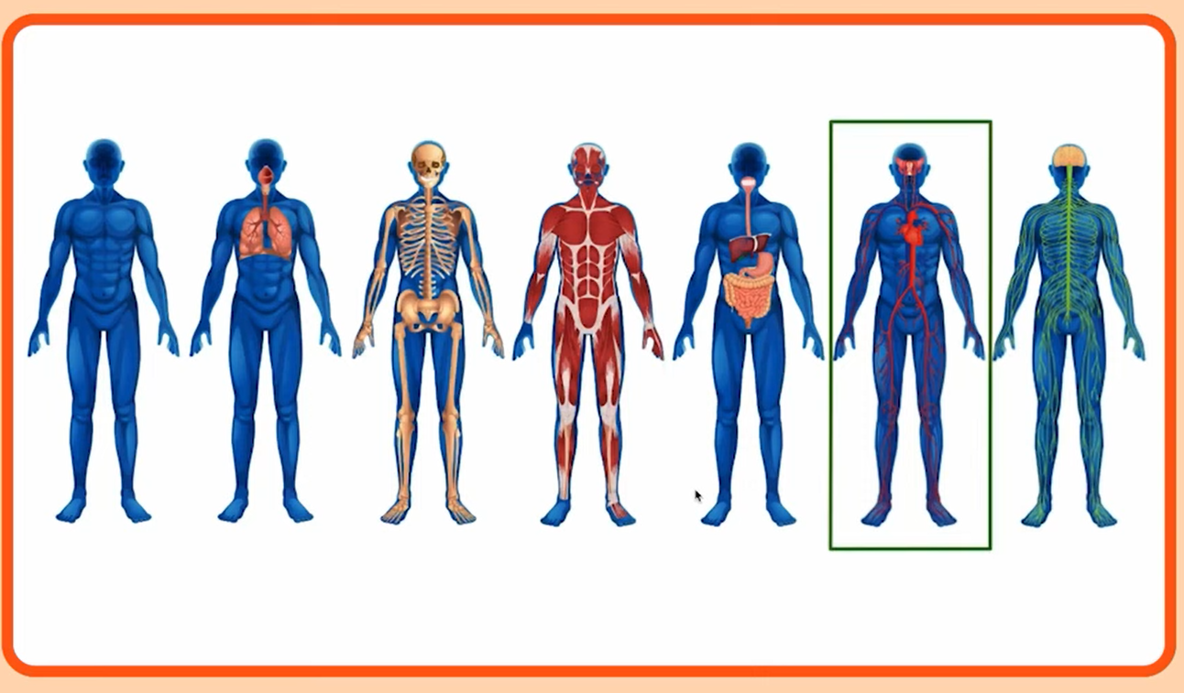
What is continuous monitoring

Slide 9
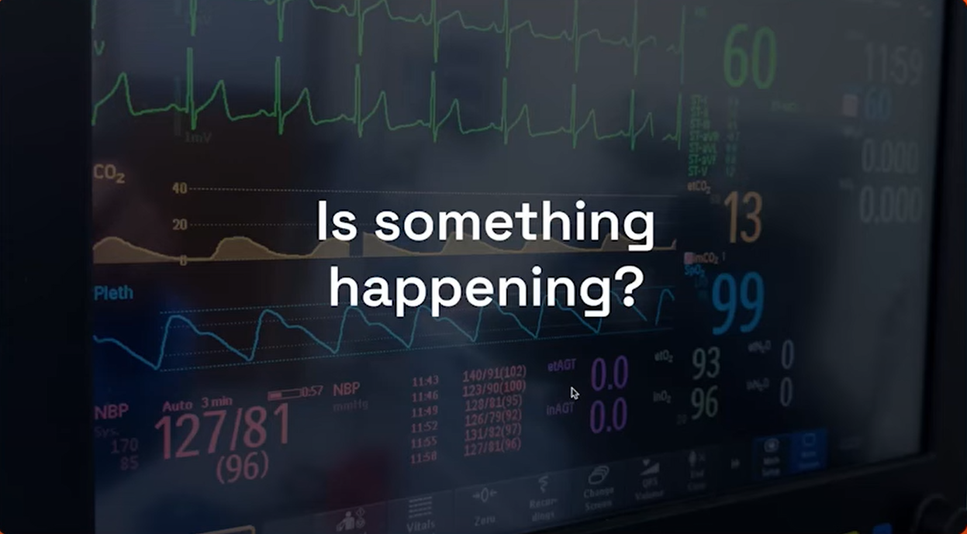
What is continuous monitoring

Slide 10

What is continuous monitoring

Slide 11
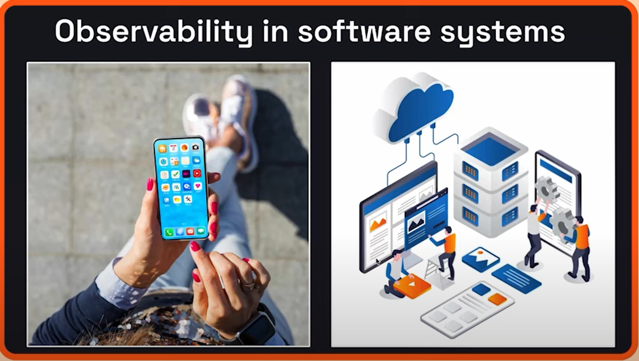
What is continuous monitoring

Slide 12
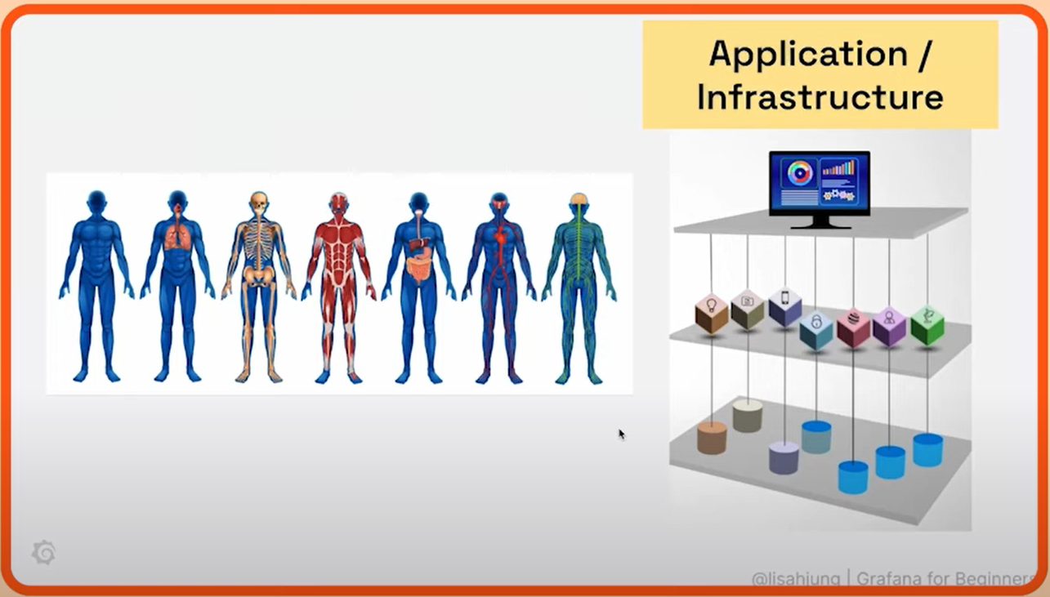
What is continuous monitoring

Slide 13
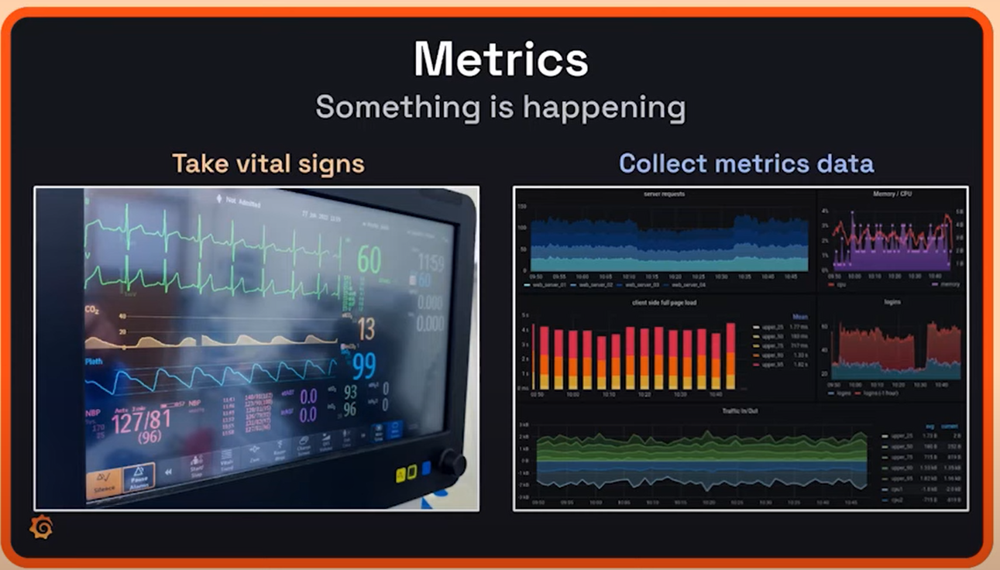
What is continuous monitoring

Slide 14
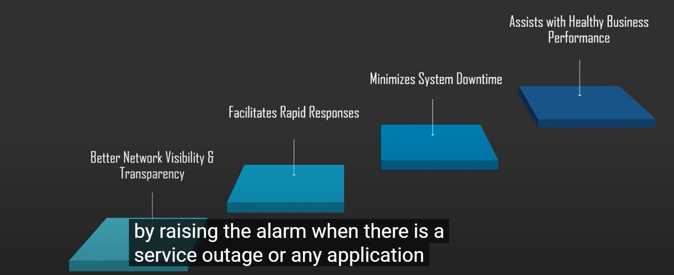
What is continuous monitoring

Slide 15
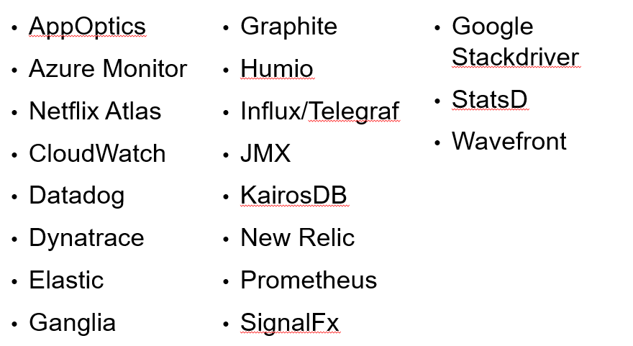
Monitoring Systems

Slide 16
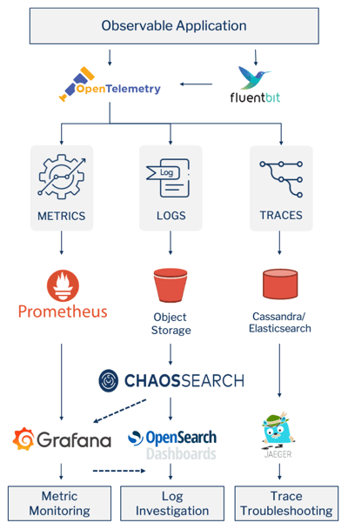
Monitoring Systems

Slide 17
What is Grafana
Grafana, an open-source data analysis solution, serves a vital role in the world of data analytics.
Its main objective is to enable data analysis using metrics.
Users can efficiently visualize their data by creating consolidated charts and graphs in a unified dashboard or multiple dashboards.
It makes us to interpret and understand complex data sets.

Slide 18
What is Grafana
Grafana has a thriving community of enthusiasts who share reusable dashboards.
Grafana supports a huge number of data sources.
The most common use case of Grafana is displaying time series data, such as memory or CPU over time, alongside the current usage data.
For organizations that prioritize data security and are cautious about transmitting data to external cloud providers, Grafana offers an exceptional advantage.
It can be deployed on-premises, ensuring that data remains within the organization’s infrastructure.

Slide 19
What is Grafana
Grafana runs as a process on our computer or server.
We access the interface through our browser.
Our dashboard can display data as single numbers, graphs, charts, or even a heat map.

Slide 20
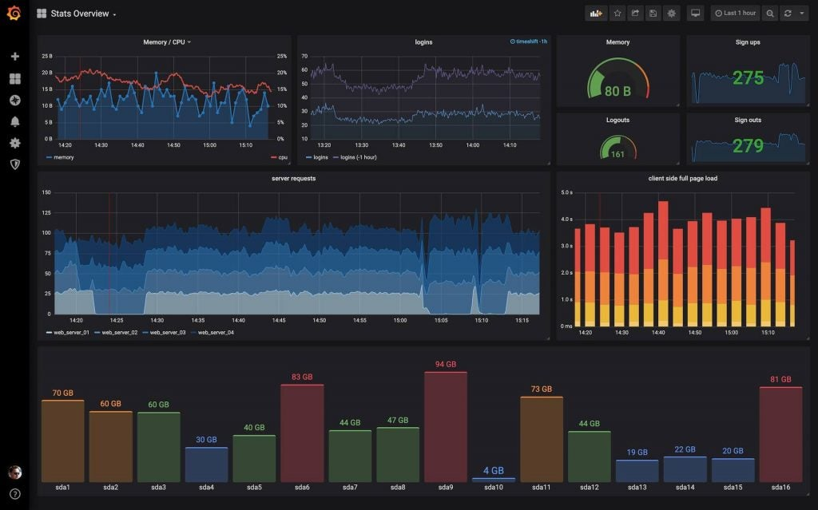
What is Grafana

Slide 21
Why do we need Grafana
Data Source Compatibility
One of the remarkable strengths of Grafana is its ability to seamlessly connect with an array of data sources.
These sources include Graphite, Prometheus, Influx DB, Elastic Search, MySQL, PostgreSQL, and many more.
Grafana allows users to develop custom plugins, affording them the flexibility to connect to data sources of their choosing.

Slide 22
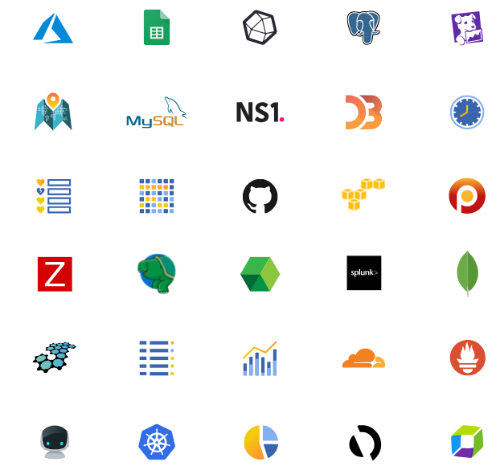
Why do we need Grafana

Slide 23
Why do we need Grafana
Time Series Analysis
Grafana excels in the domain of time series analysis, making it an invaluable tool for
tracking user behaviour,
monitoring application performance,
assessing error frequencies across diverse environments (production, pre-production, etc.),
categorizing error types,
understanding contextual scenarios.
These insights are instrumental in improving operational performance and making informed decisions.

Slide 24
Grafana Features
Dashboard templating
One of Grafana’s most important functions, dashboard templating helps you to build dashboards that can be reused for different purposes and shared among your organization’s teams.
Provisioning.
While it’s easy to construct a single dashboard by clicking, dragging, and dropping, users who need a lot of dashboards will want to use a script to automate the process.
Grafana allows you to script anything and get control of many dashboards.

Slide 25
Grafana Features
Kiosk mode and playlists
If we want to display your Grafana dashboards on a TV monitor we can use the playlist function to choose which dashboards we need to look through and make them cycle through on the screen.
In view-only mode, the kiosk mode hides all the user interface elements you don’t need.
Custom plugins
We can use plugins to extend Grafana and integrate it with other software, visualizations, and more.
Anything that produces a timestamp and a value can be visualized in Grafana with just a few lines of code.

Slide 26
Grafana Features
Alerting and alert hooks.
If an anticipated scenario occurs, alerts are activated like tripwires.
These events can be reported to the monitoring team through Slack or some other communication channel.
Permissions and teams.
When a company has one Grafana and several teams, they often want to keep things apart while still sharing dashboards.
If we’re using Grafana Enterprise, we can build a team of users and then set permissions on folders, dashboards, and down to the data source level.
SQL data sources
Grafana’s native SQL support allows you to turn anything in a SQL database into metric data that you can graph.
SQL data sources are used by power users to do a variety of fascinating things, such as building business dashboards.

Slide 27
Grafana Features
Authentication
Grafana supports a variety of authentication styles, including LDAP and OAuth, and lets you map users to organizations.
We can also map users to teams in Grafana Enterprise:
Grafana helps us to map the teams in our internal systems to Grafana teams if our organization has its own authentication system.
As a result, we’ll be able to automatically grant access to the dashboards to employees that belong to specific teams.

Slide 28
Why is Grafana so Popular?
Grafana has garnered substantial popularity among professionals, including product leaders, security analysts, and developers.
They rely on Grafana to make data-driven decisions, monitor performance, and gain critical insights into their systems.
The main alternatives to Grafana are Kibana, Tableau and Power BI.
All of them are also tools that offer data visualization and analysis capabilities.
It provides users with options to select the solution that best aligns with their specific requirements.

Slide 29
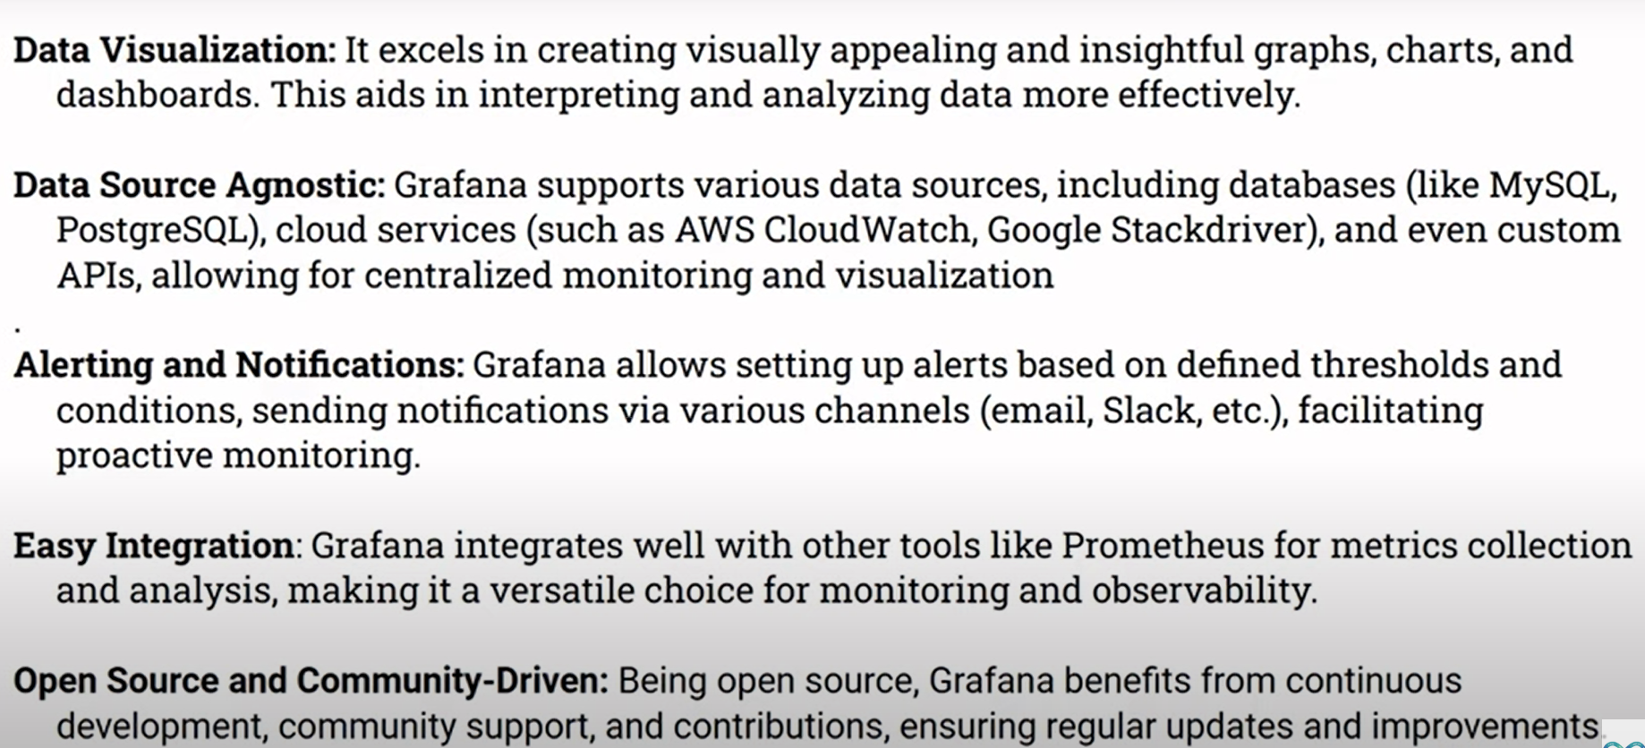
Advantage and Disadvantage of Grafana

Slide 30
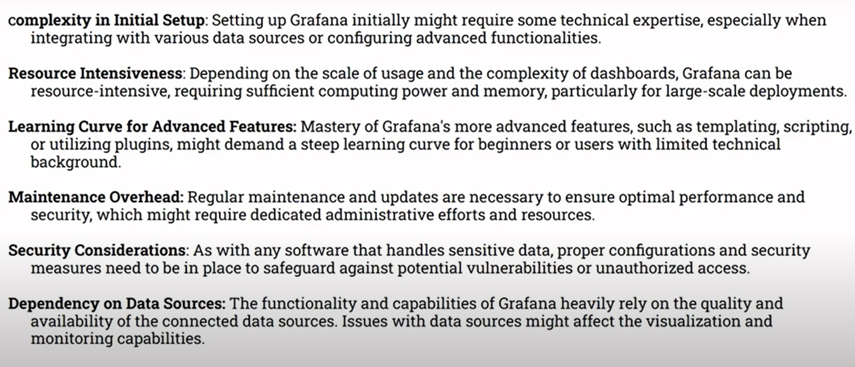
Advantage and Disadvantage of Grafana

Slide 31
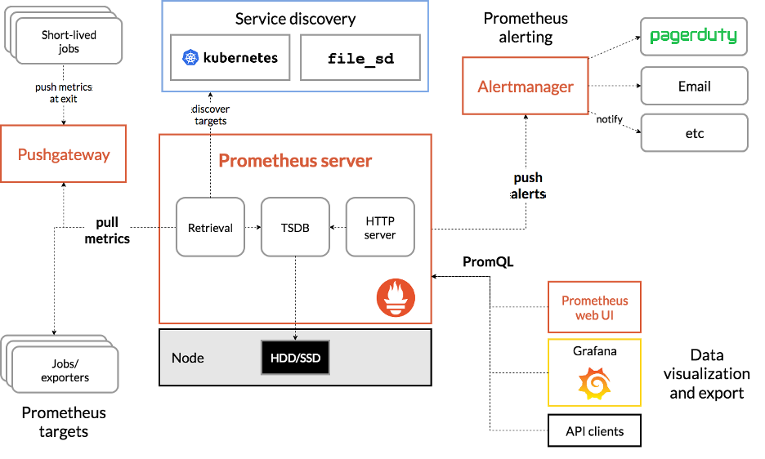
Grafana with other Tools

Slide 32
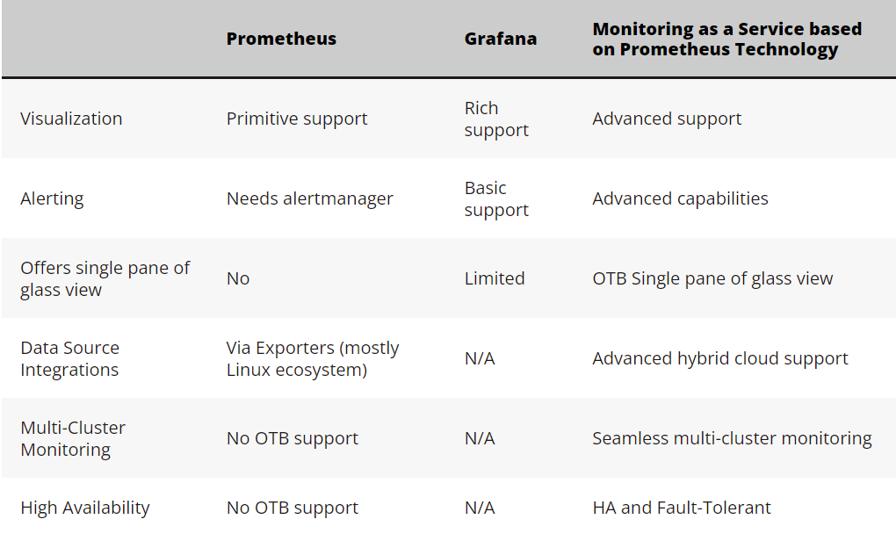
Prometheus vs Grafana

Slide 33
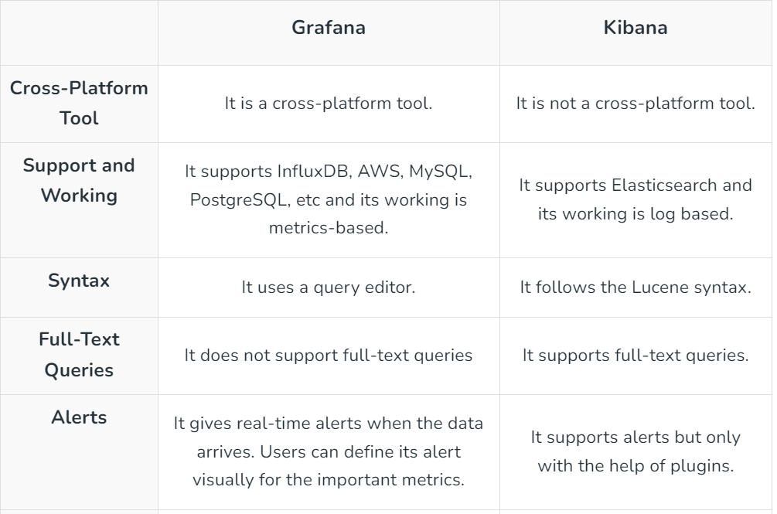
Grafana vs Kibana

Slide 34
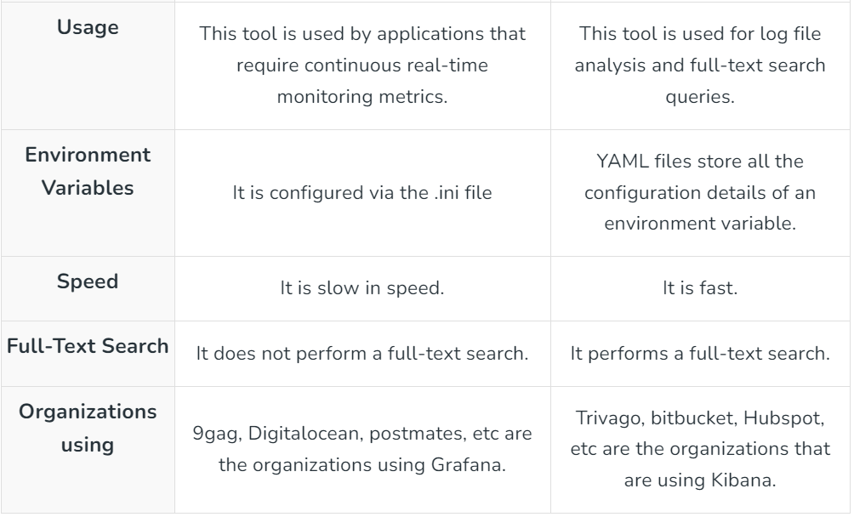
Grafana vs Kibana

Slide 35
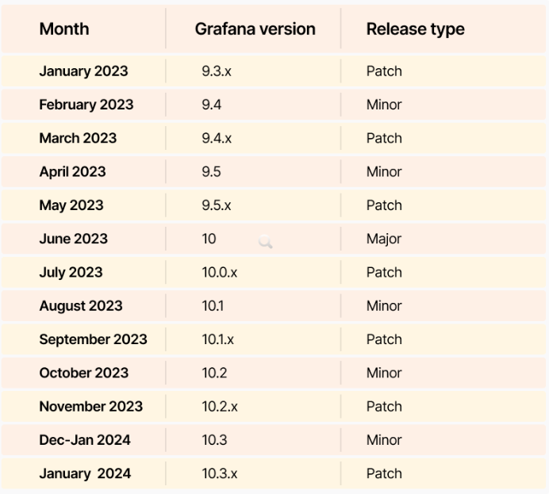
Grafana Releases

Slide 36
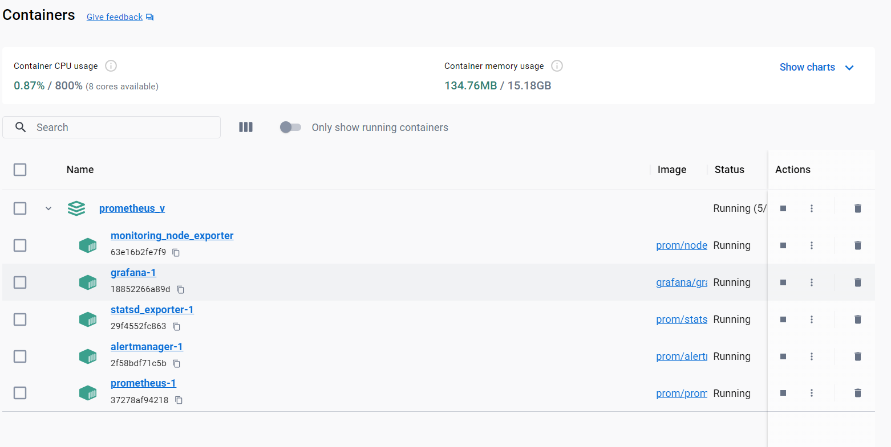
Grafana Installation

Slide 37
Grafana Loki
Loki is an open-source log aggregation tool inspired by Prometheus architecture.
It is designed as horizontally-scalable, highly-available, and multi-tenant to allow you to collect, store, and search log data.
Loki was created by Grafana Labs, with its first version released in 2019.
Loki is designed to keep indexing low.
It does this by making use of labels.
Labels are any key-value pairs that can be used to describe a log stream.

Slide 38
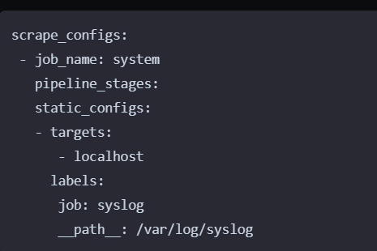
Grafana Loki

Slide 39
Key Features of Grafana Loki
It provides you with LogQL as its own query language, allowing you to powerfully query and filter your logs.
Has support Grafana integration for real-time log visualizations and querying.
It uses labels to identify log streams.
Natively integrates with Prometheus, Grafana and K8s.
PromQL-compatible to allow you access to Prometheus-like labels. This makes Loki easier to use to categorize and label log data while using PromQL to search and analyze logs.
Prometheus Alert manager for sending alerts.
Cost-effective and durable storage as Loki doesn't index logs text contents. It only needs labels for each log stream.
Multi-tenancy support through to allows each tenant's data to be stored independently.

Slide 40
Grafana Loki Installation
wget https://raw.githubusercontent.com/grafana/loki/v3.0.0/production/docker-compose.yaml -O docker-compose.yaml

Slide 41
Get started with Grafana Cloud
To sign up for a Grafana Cloud account, complete the following steps:
Navigate to https://grafana.com/products/cloud/.
Click Start for free on the banner.
Follow the instructions to finish setting up your account and access the Cloud Account Portal.

Slide 42
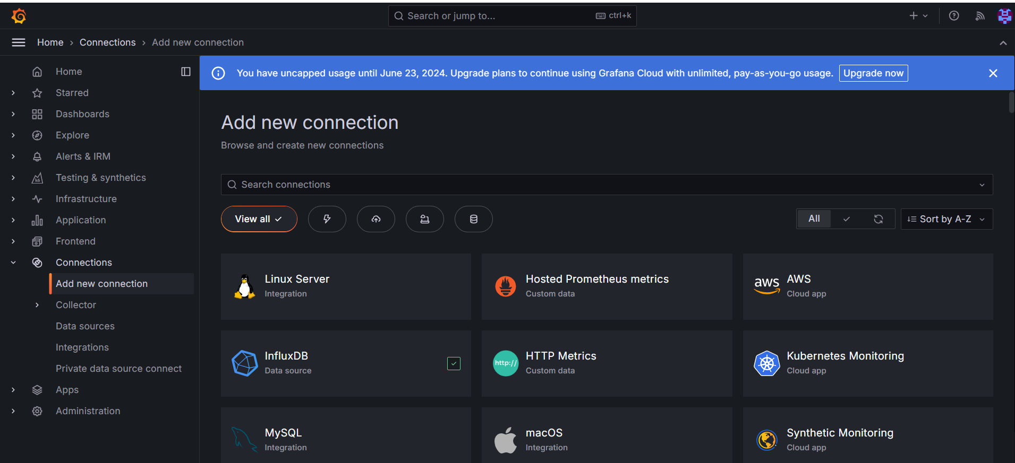
Get started with Grafana Cloud

Slide 43
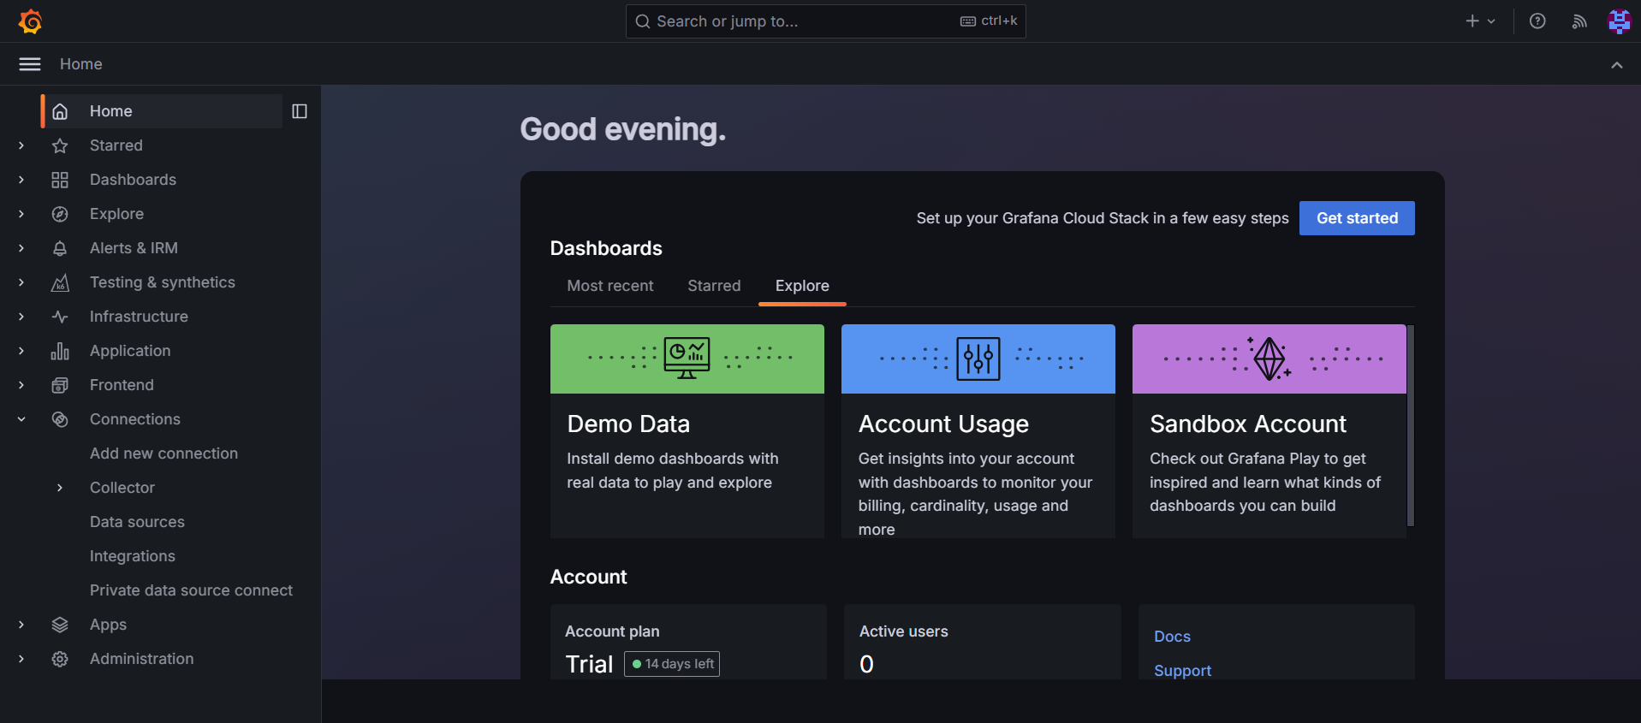
Get started with Grafana Cloud

Slide 44
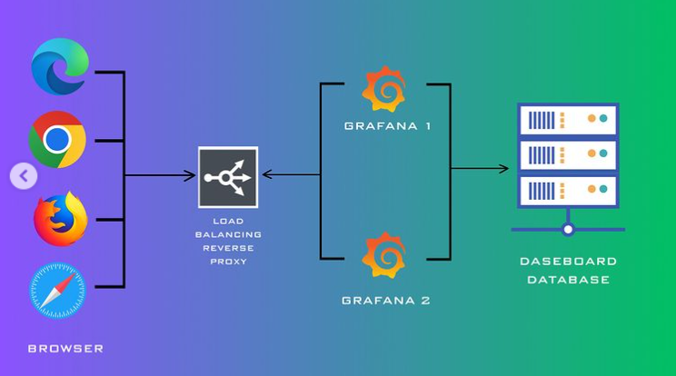
How Grafana Works

Slide 45
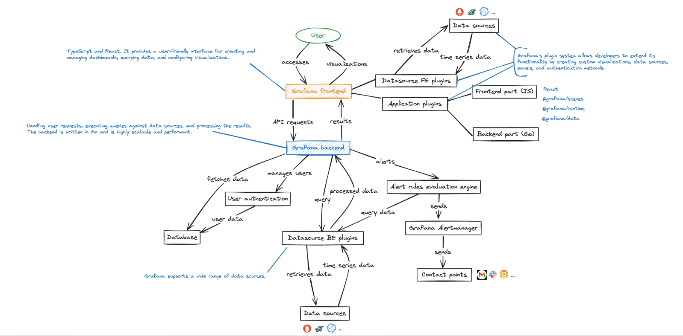
Grafana Architecture

Slide 46
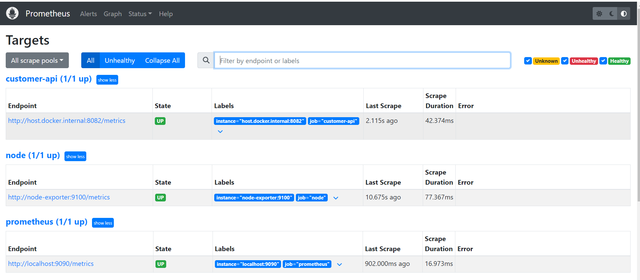
Grafana Prometheus Connection

Slide 47
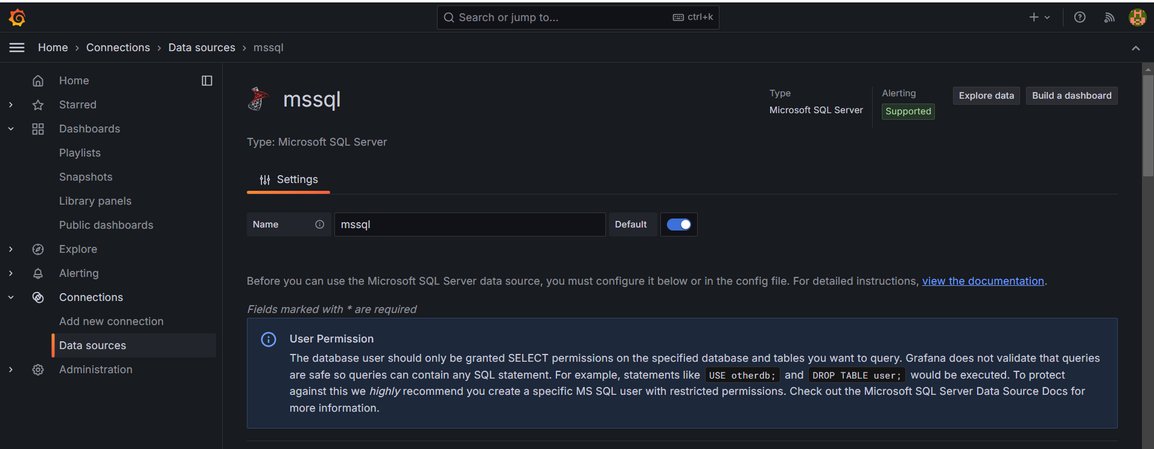
Grafana MSSQL Connection

Slide 48
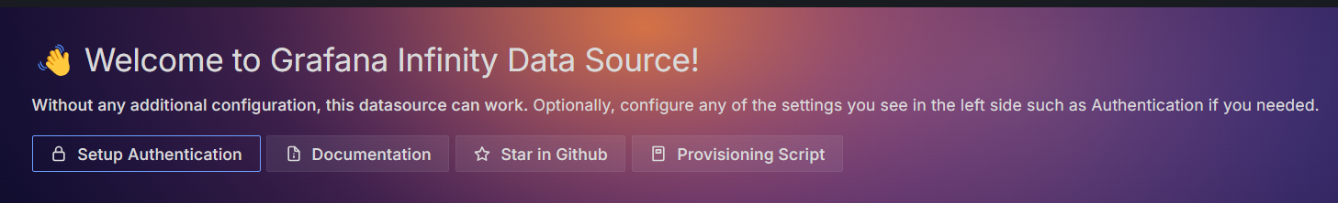
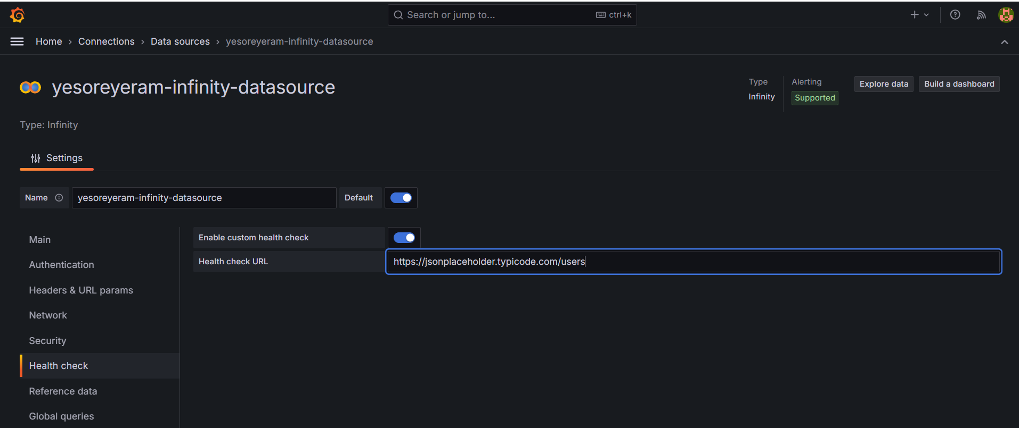
Grafana Infinity DB – AI/LLM Native DB– JSON Data
No need to create container.
Just add infinity db plugin and create data source.

Slide 49
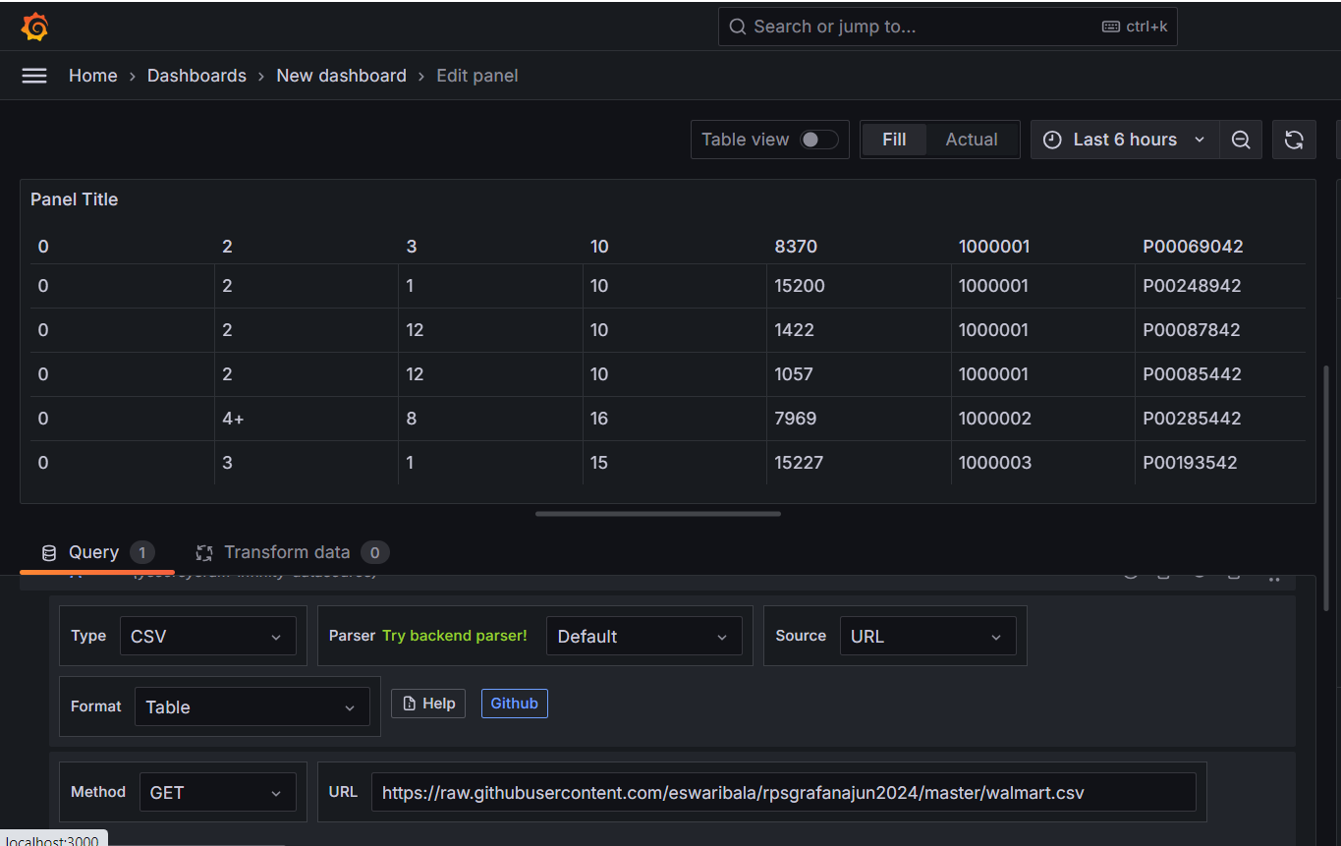
Grafana Infinity DB - CSV

Slide 50
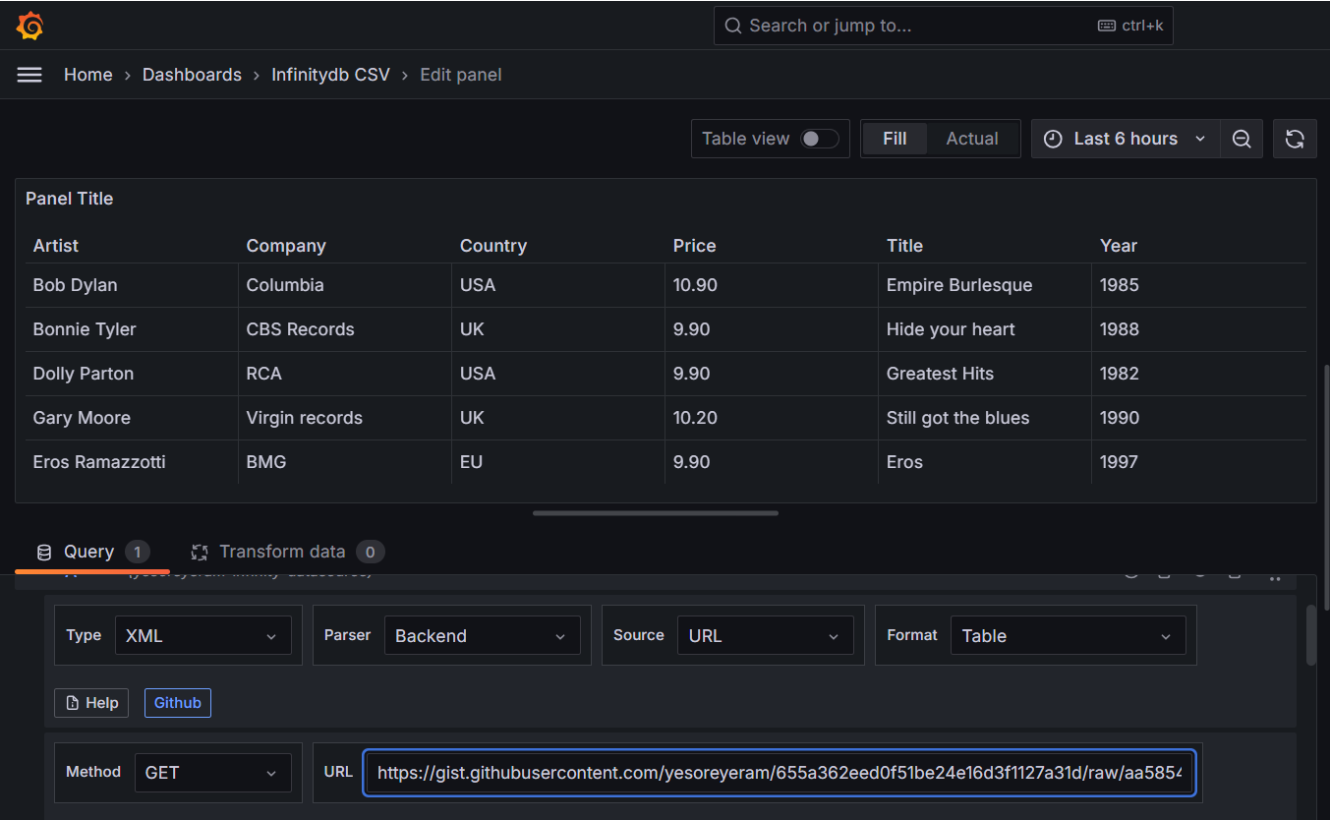
Grafana Infinity DB - XML

Slide 51
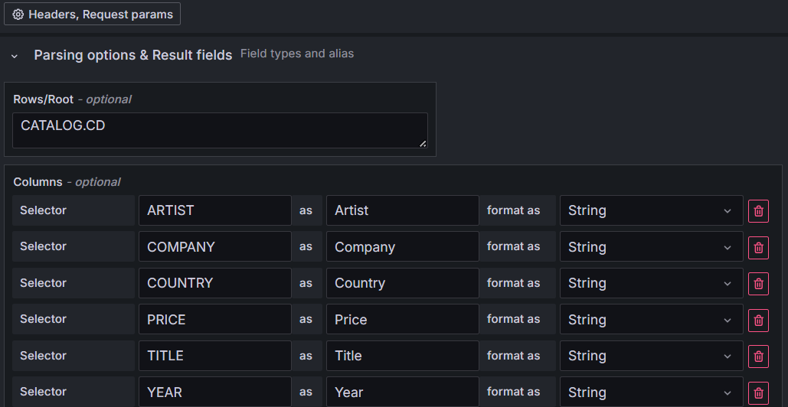
Grafana Infinity DB - XML

Slide 52
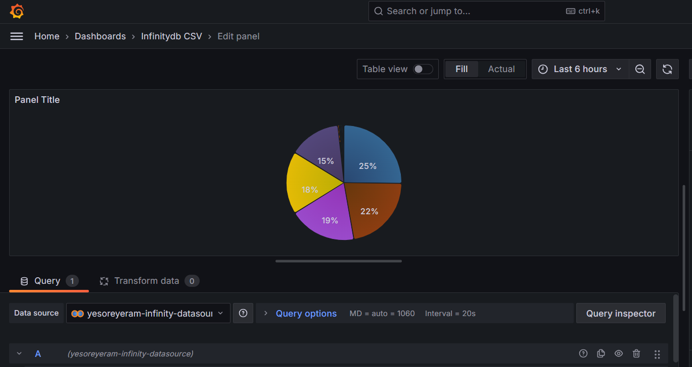
Grafana Infinity DB - XML

Slide 53
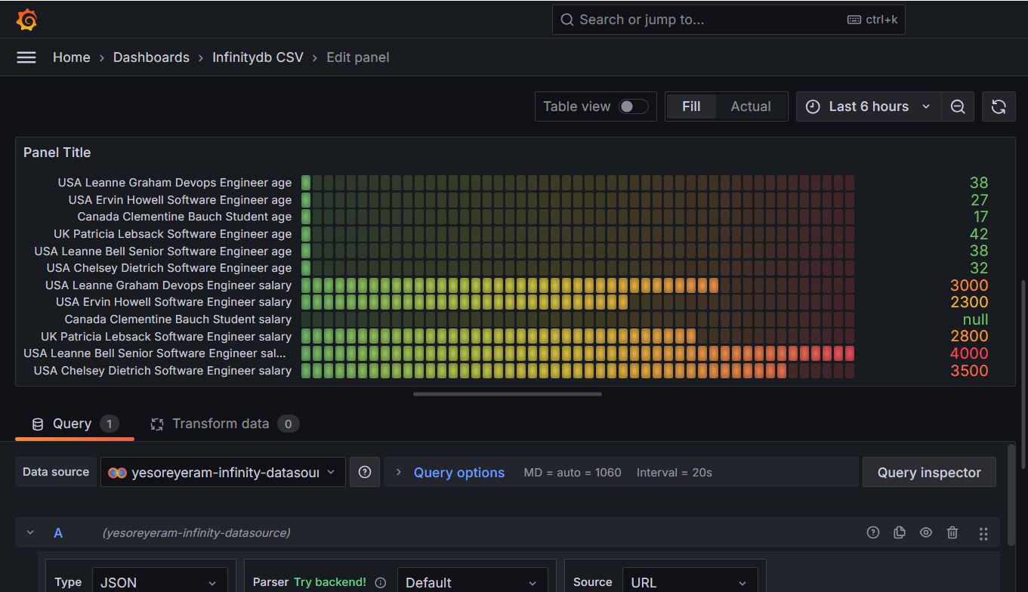
Grafana Infinity DB - XML

Slide 54
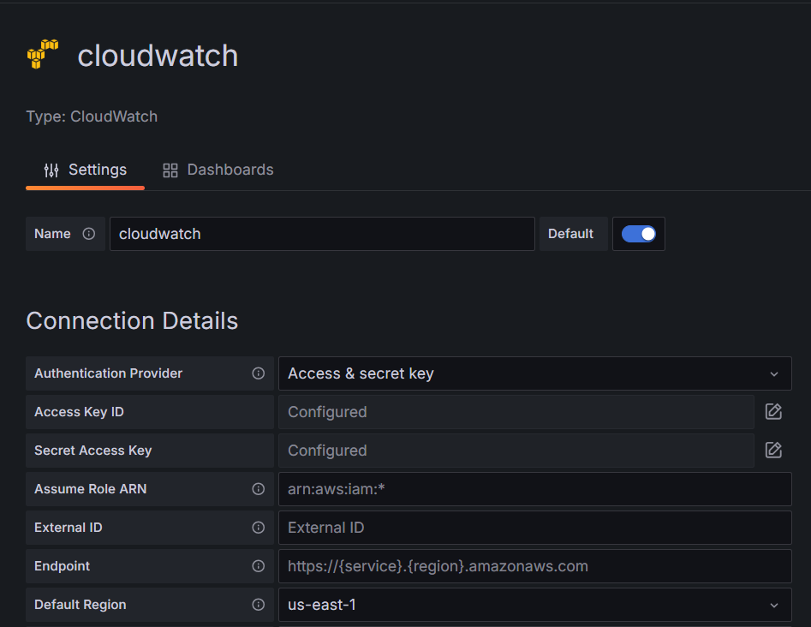
Amazon Cloud Watch as Data Source

Slide 55
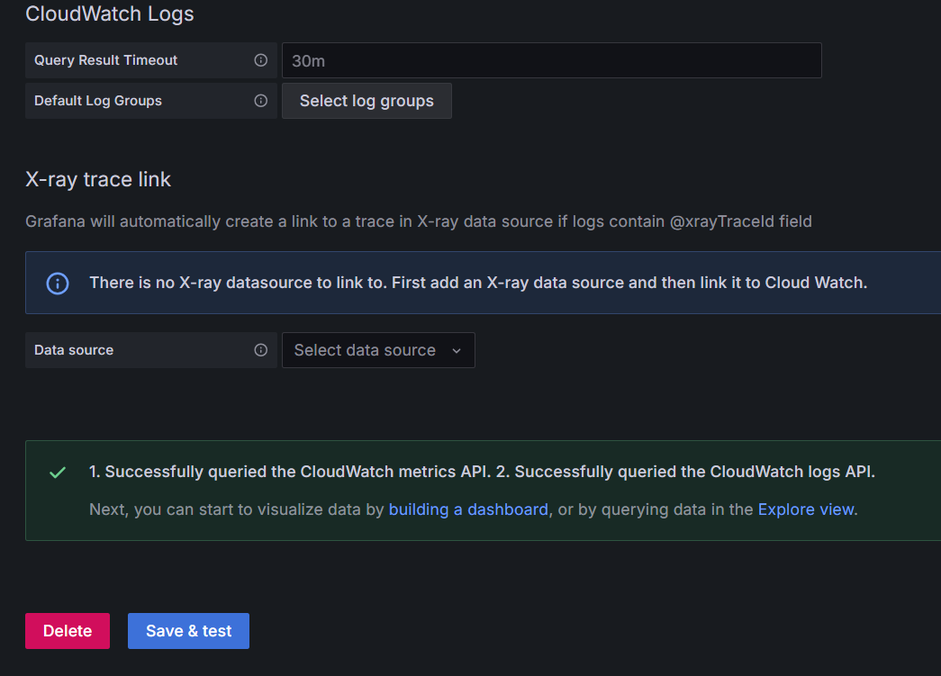
Amazon Cloud Watch as Data Source

Slide 56
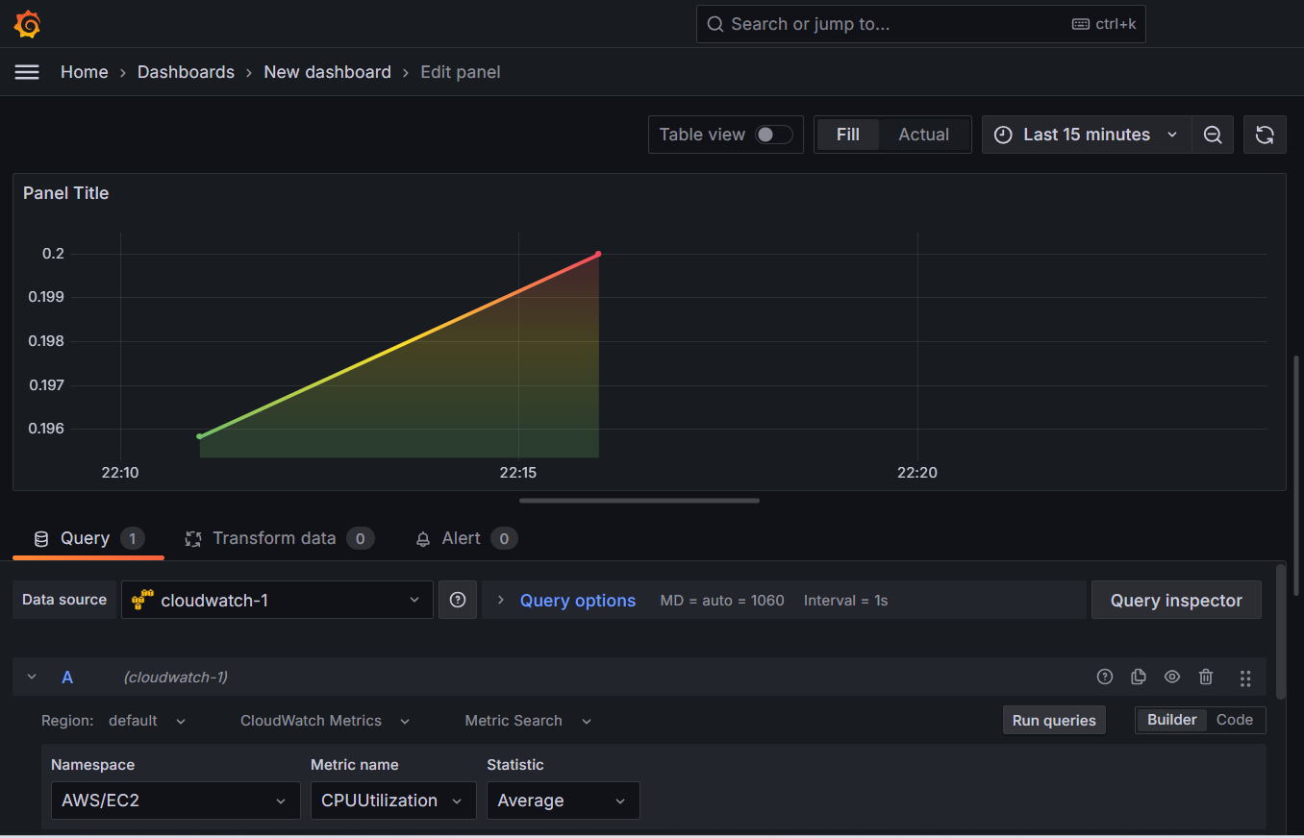
Amazon Cloud Watch as Data Source

Slide 57
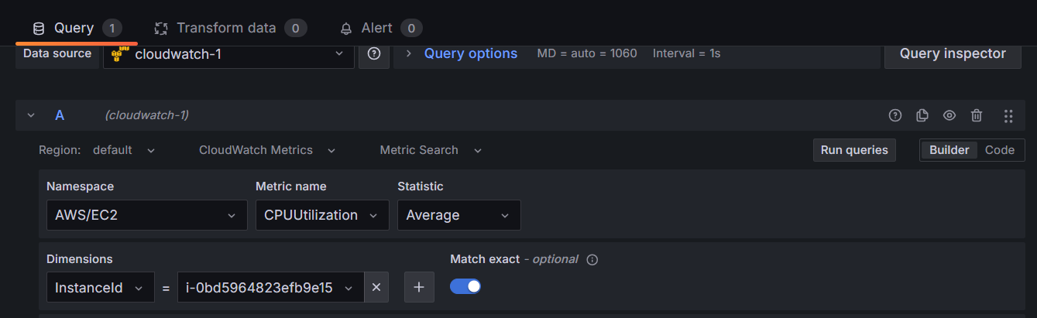
Amazon Cloud Watch as Data Source

Slide 58
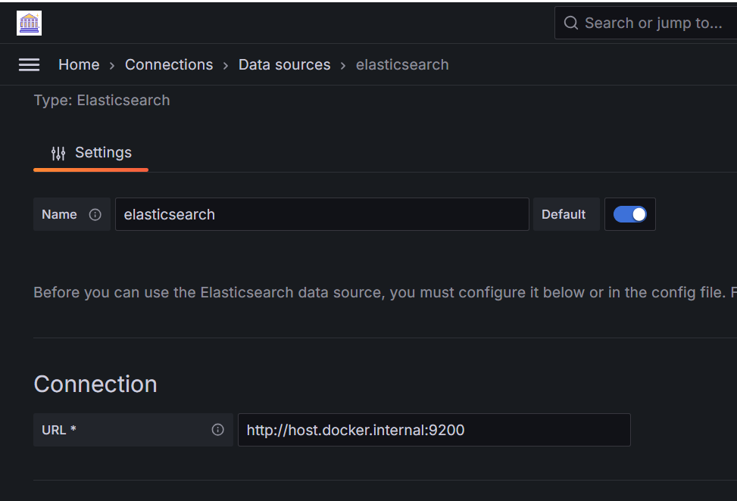
Grafana Elastic Search

Slide 59
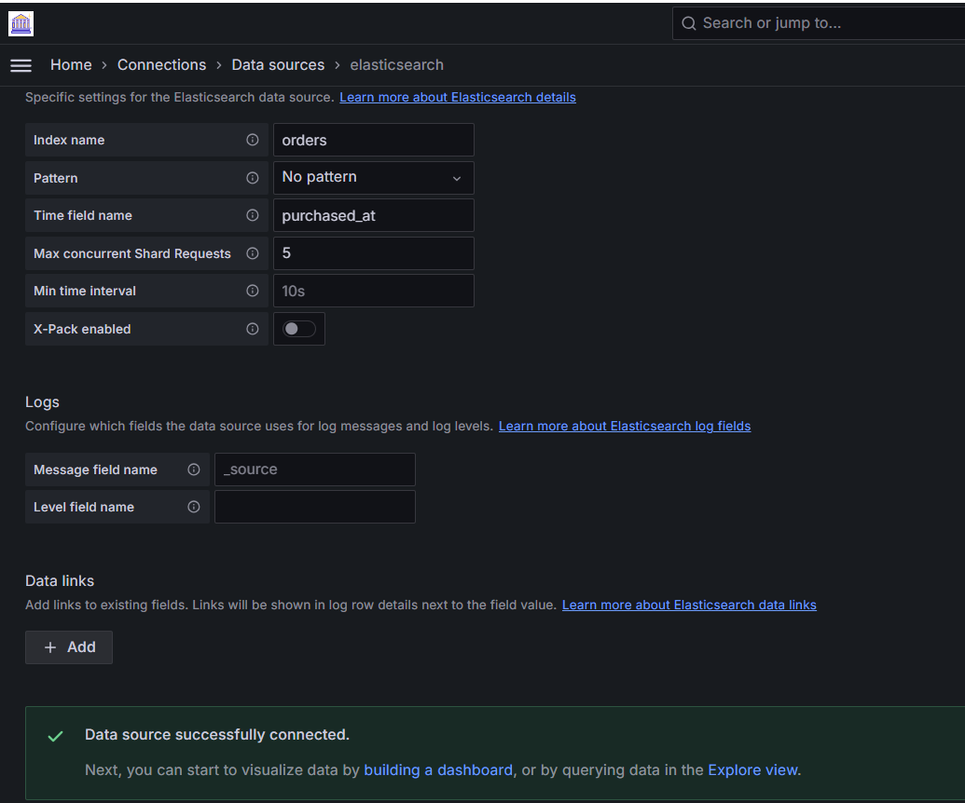
Grafana Elastic Search

Slide 60
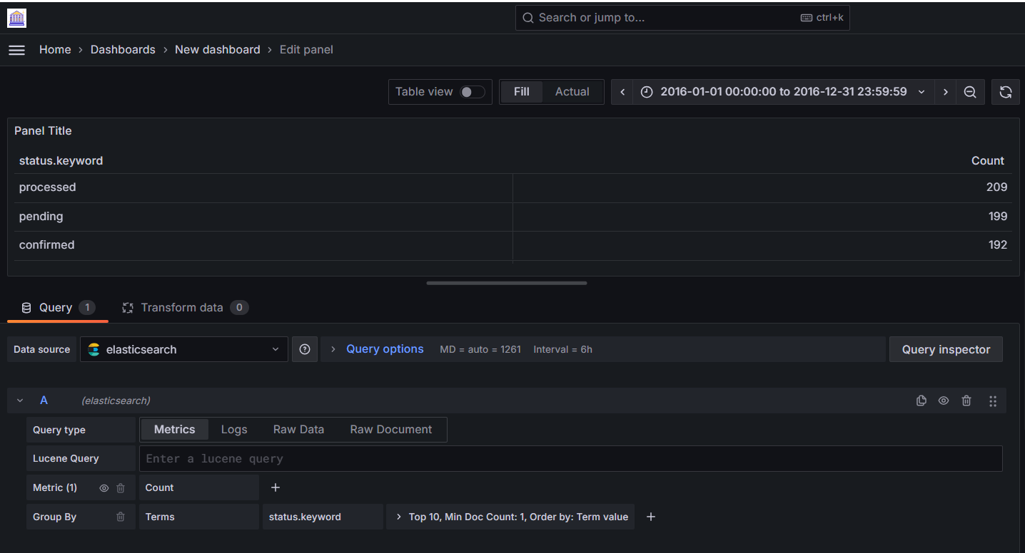


Grafana Elastic Search with Top10
Graphite has the limit function.
InfluxDB has the limit and slimit functions
ElasticSearch has the Size option:

Slide 61
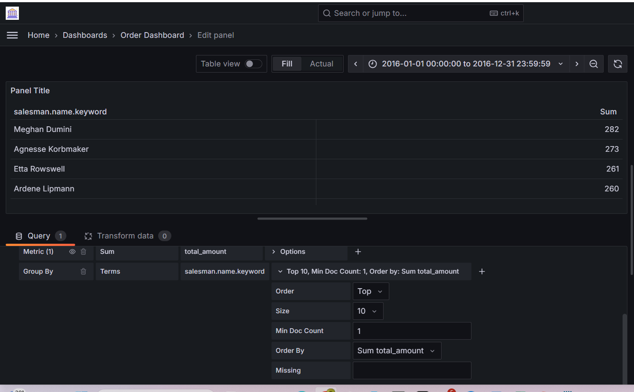
Grafana Elastic Search with Top10

Slide 62
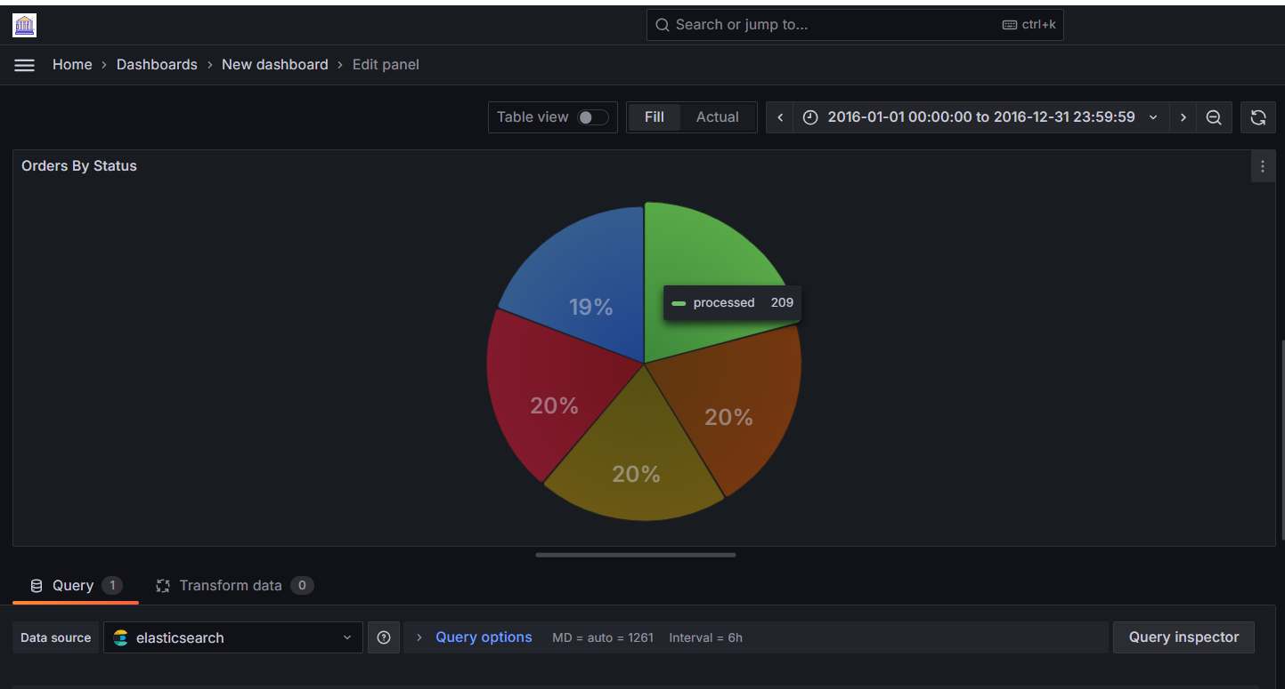
Grafana Elastic Search

Slide 63
Dashboard Playlists
A playlist is a list of dashboards that are displayed in a sequence.
We might use a playlist to build situational awareness or to present your metrics to our team or visitors.
Grafana automatically scales dashboards to any resolution, which makes them perfect for big screens.
We can access the Playlist feature from Grafana’s side menu, in the Dashboards submenu.

Slide 64
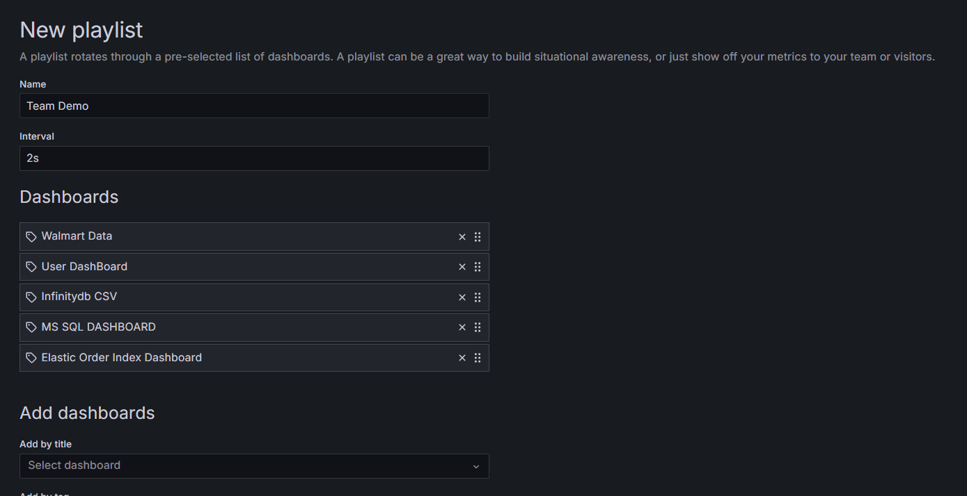
Dashboard Playlists

Slide 65
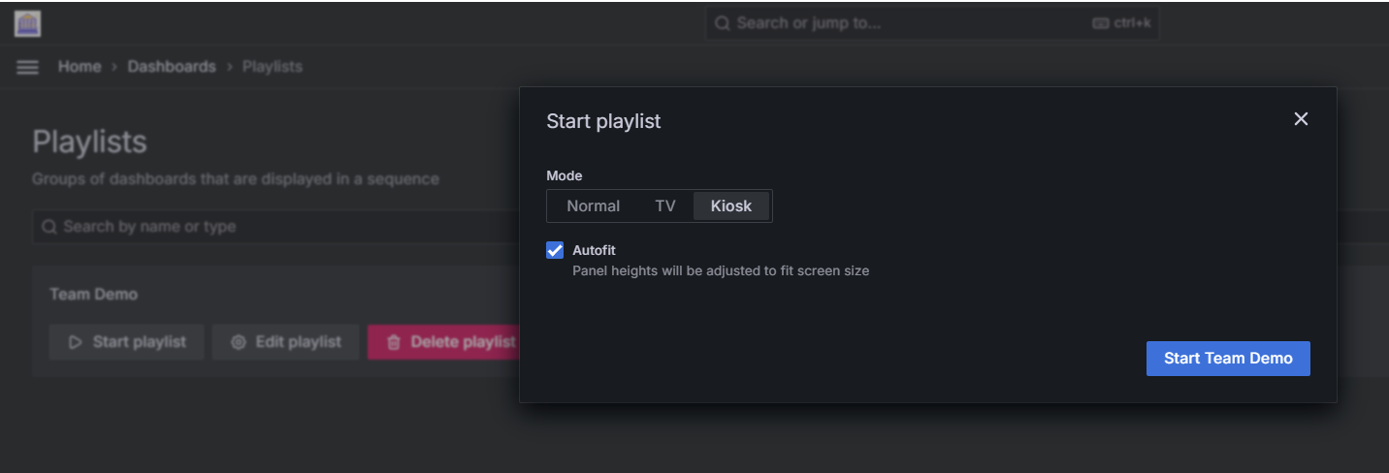
Dashboard Playlists

Slide 66
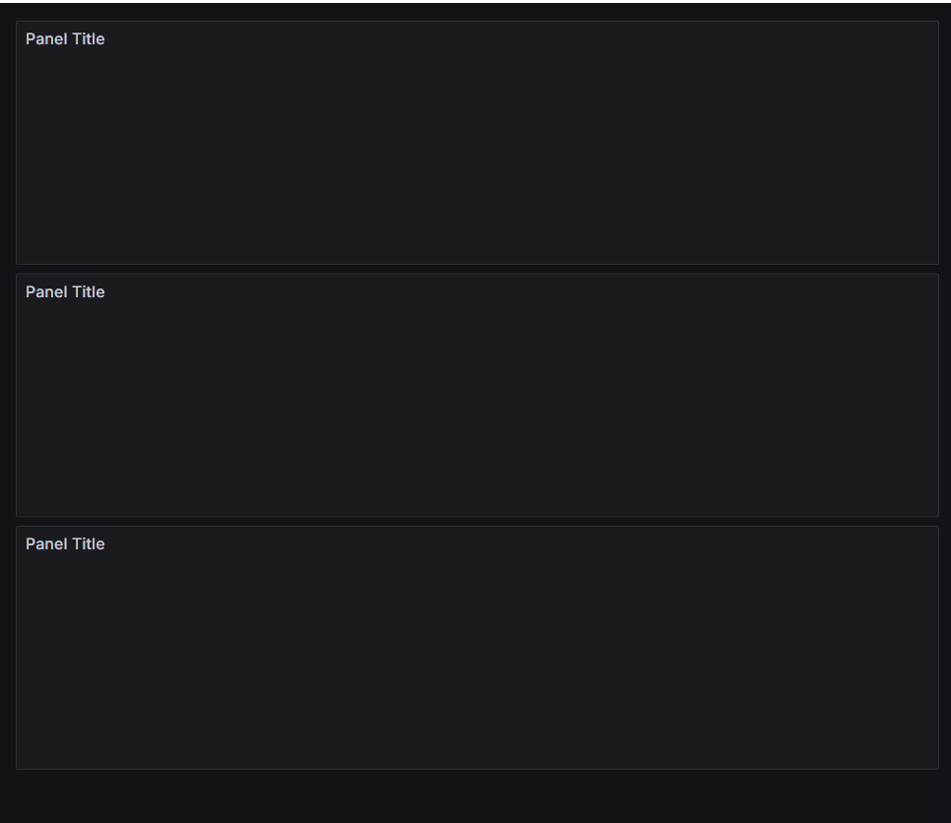
Dashboard Playlists

Slide 67
Create and manage reports
Reporting enables you to automatically generate PDFs from any of your dashboards and have Grafana email them to interested parties on a schedule.
This is available in Grafana Cloud and in Grafana Enterprise.

Slide 68
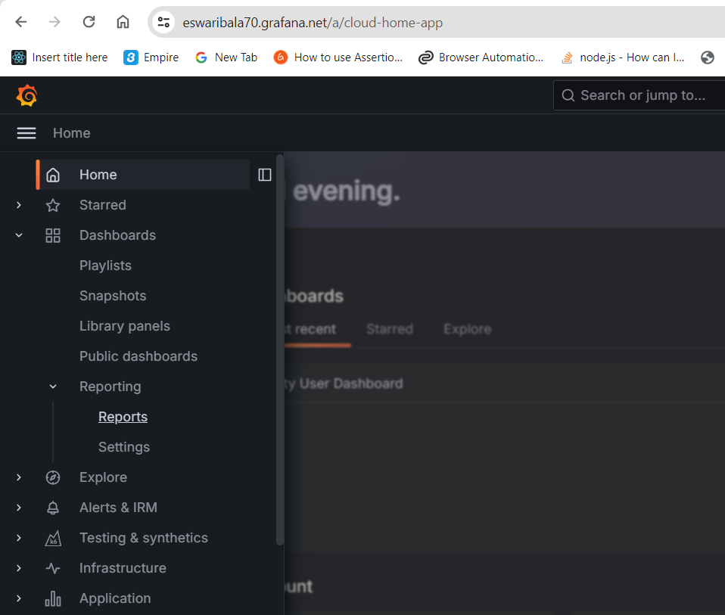

Create and manage reports

Slide 69
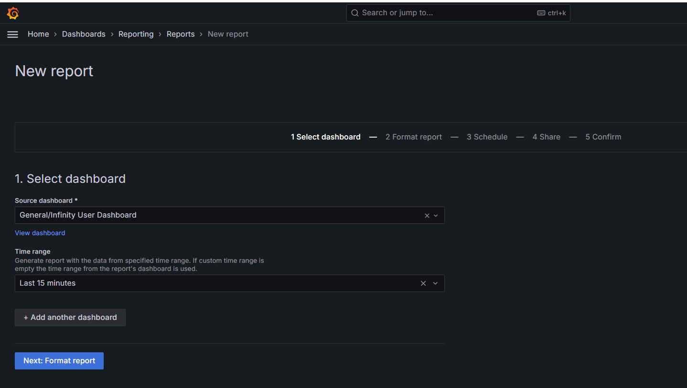
Create and manage reports

Slide 70

Create and manage reports

Slide 71

Create and manage reports

Slide 72
Grafana Alerting
Grafana Alerting typically allows us to learn or understand the problems in our system, just a few moments after they occur.
Enabling us to create, manage, and act on our alerts in a single, consolidated view, and overall improve our team’s ability to identify and resolve issues as fast as possible.
It is available for Grafana OSS, Grafana Enterprise, or Grafana Cloud.

Slide 73

How do Grafana alert works

Slide 74

How do Grafana alert works

Slide 75


How do Grafana alert works (Only Time Series)

Slide 76

How do Grafana alert works

Slide 77

How do Grafana alert works

Slide 78
Grafana OAuth
There are numerous authentication methods available in Grafana to verify user identity.
The authentication configuration dictates which users can access Grafana and the methods they can use for logging in.
We can also configure Grafana to automatically update users’ roles and team memberships in Grafana based on the information returned by the auth provider integration.
When deciding on an authentication method, it’s important to take account your current identity and access management system.
We should also consider the specific authentication and authorization features you require.

Slide 79
Grafana OAuth
Grafana provides OAuth2 integrations for the following auth providers:
Azure AD OAuth
GitHub OAuth
GitLab OAuth
Google OAuth
Grafana Com OAuth
Keycloak OAuth
Okta OAuth

Slide 80

Grafana GITHUB OAuth2 Authentication

Slide 81

Grafana GITHUB OAuth2 Authentication

Slide 82


Grafana GITHUB OAuth2 Authentication

Slide 83

Azure Active Directory- Microsoft Entra ID

Slide 84


Azure Active Directory- Microsoft Entra ID

Slide 85

Azure Active Directory- Microsoft Entra ID

Slide 86

Azure Active Directory- Microsoft Entra ID

Slide 87

Azure Active Directory- Microsoft Entra ID

Slide 88

Azure Active Directory- Microsoft Entra ID

Slide 89

GITLAB Setup

Slide 90

GITLAB Setup

Slide 91



Dashboard Link

Slide 92

Dashboard Link

Slide 93

Panel Link for Various Time Range

Slide 94

Panel Link for Various Time Range

Slide 95

Panel Link for Various Time Range

Slide 96

Image Renderer

Slide 97

Image Renderer using docker-compose

Slide 98

Image Renderer-Grafana.ini

Slide 99

Grafana Elastic Query Variable

Slide 100

Grafana Elastic Query Variable

Slide 101

Grafana Elastic Query Variable

Slide 102

Grafana Prometheus Query Variable

Slide 103


Grafana Prometheus Query Variable

Slide 104

Grafana Prometheus Query Variable

Slide 105

Grafana Cloud Watch Query Variable

Slide 106

Grafana Cloud Watch Query Variable

Slide 107

Grafana Cloud Watch Query Variable

Slide 108

Grafana Cloud Watch Query Variable

Slide 109

Grafana Cloud Watch Query Variable

Slide 110

Grafana MSSQL Query Variable

Slide 111

Grafana MSSQL Query Variable

Slide 112

Grafana MSSQL Query Variable

Slide 113

Grafana Postgres Query Variable

Slide 114

Grafana MSSQL Query Variable

Slide 115

Grafana Infinitydb Query Variable

Slide 116

Grafana Infinity db Query Variable

Slide 117

Configure Vault with Grafana

Slide 118

Loki

Slide 119

Loki

Slide 120
Loki
wget https://raw.githubusercontent.com/grafana/loki/v3.0.0/production/docker-compose.yaml -O docker-compose.yaml

Slide 121

Grafana Customization Cheatsheet

Slide 122

Grafana Customization Cheatsheet

Slide 123

Grafana Customization Cheatsheet

Slide 124
Questions

Slide 125
Module Summary
What is Grafana
How Grafana Works
Grafana Installation
DataSources
Dashboards

